Slide 1

Procurement Card Program
Office of Resources Management
Welty Hall Room 309
662-329-7126
purchase@muw.edu
Melissa Buxton
Director of Resources Management
Procurement and Property Control
Trent Bush
Moving Supervisor

Slide 2

P Card Care
A Procurement card should be treated LIKE it’s YOUR OWN PERSONAL CREDIT or debit CARD
We encourage mindful spending
Cardholders should NEVER allow individuals within their department borrow their card
  A student worker is not authorized to make purchases with the Procurement card.
P cards should be kept in a secure location – locked office cabinet or vault
Keep the P card separate from personal credit cards

Slide 3
P card Purchases
Competitive Contracts
Negotiated Contracts
You are REQUIRED to purchase from an approved vendor if your item is on a competitive contract
  Copier Paper –Imperial Dade
  Office Supplies – Barefield Workplace Solutions & Mississippi Industries for the Blind
Barefield Workplace Solutions – Laundry List – State Contract. [search bar ‘state contract’ does not work for this site] If the item you need to purchase ISN’T on this list then check Mississippi Industries for the Blind
Mississippi Industries for the Blind – Type in State Contract in the search bar. If your item isn’t listed as a state contracted item, check Barefield. If it’s not on Barefield you may shop around – be mindful of your spending.
It is strongly encouraged to purchase from vendors who fall under Negotiated Contracts if your item isn’t on a competitive state contract.
Negotiated contracts are used by many but don’t always meet the needs for everyone – that’s why they are encouraged but not required.
If the item is not on state contract – follow basic procurement card and purchasing laws

Slide 4
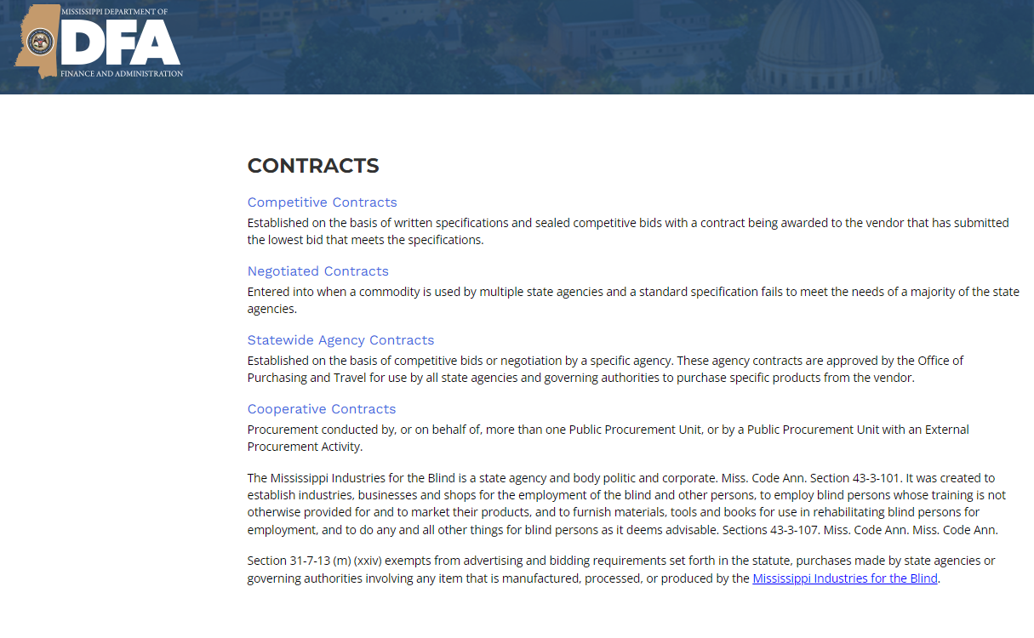
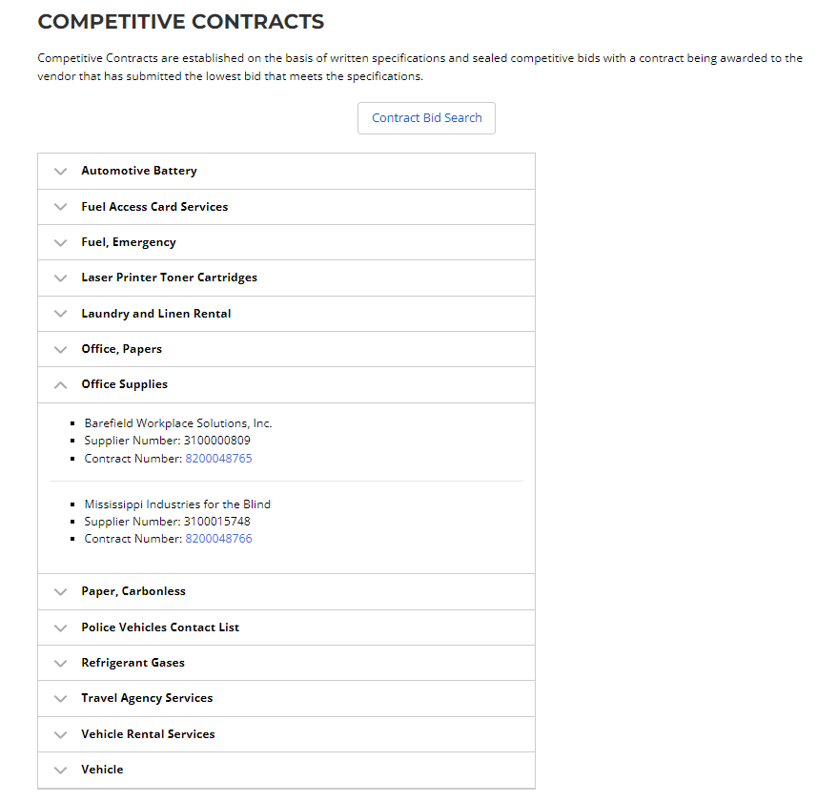
Clickable links will take you to a list of categories that fall under that contract
Click on the category you need to purchase – it will list the authorized vendor(s)
https://www.dfa.ms.gov/bureau-purchasing-and-contracting

Slide 5


Before using the Procurement card
Is your item a commodity or service? – if it doesn’t fit in these 2 categories you will need to verify with Resources Management
Does this purchase split orders in order to circumvent a contract or card policies in anyway? Bad idea - Don’t do it!
Is this a specialty item?
If it’s special – it’s probably not allowed
If ordering from an Online Vendor:
Request the taxes be removed from the order – if the vendor is out-of-state
State of Mississippi Taxes shouldn’t be charged to the P Card – even for online, in- state orders
Is there enough money to pay for this purchase within your department?
[Couch coins do not count]
Know your card’s single item transaction limit & monthly card limit
P Cards are not authorized to be charged a convenience or service fee.
If the card is charged this fee, you are responsible for having the charge credited back or pay for the fee - It is important to make sure you will not be charged this before swiping the card or keying in the card number

Slide 6
Using the P Card for a Service?
The P card can be used for Contractual Services ONLY IF the business is a LLC Corporation or LLC-S Corporation
  (LLC – limited liability company – protects the company’s owner’s personal assets from the company’s debts)
  (LLC-S Corp - is just a tax classification of an LLC – doesn’t pay corporate income tax like an LLC. S Corp company profits pass through the owner’s personal tax returns)
It is a violation to use the P card with contractual services to an individual, Sole Proprietor, Partnership or LLC-Partnership
Contracts are required for ANY service
We now REQUIRE a W-9 for every service contract – this is to ensure the service is with a LLC or LLC-S
Contracts are to be uploaded into Contract Safe along with the company’s W-9
    Wait for full contract approval before receiving service

Slide 7
Steps for P card purchases
Decide if the product you need to purchase is on State Contract
  If a service – upload W 9 and contract into Contract Safe. Must receive full approval before moving forward
Order item(s) – KEEP ALL RECEIPTS. Receipts MUST be itemized
Receive ordered item(s) from vendor – Back orders are not allowed to be charged to the P card
Complete the Transaction Form
  If food was purchased to either consume or to use, a Food Memo form AND Food Purchase form are REQUIRED
    (All forms are on Resources Management’s webpage)
  Freight or shipping charges should be listed on a separate line than the product that was purchased since it uses a separate object code
Print Statements from us bank P Card site– match receipts to monthly statement
Card holder AND supervisor must sign the statement and Transaction Form
Send original documentation to Resources Management [w-1628] by the 10th of each month

Slide 8
Prohibited Purchases
Equipment or Inventory items:
Other items:
    Mississippi Sales Tax – card holder is responsible for communicating this before making a purchase with the card in the state of Mississippi – you will have to pay this back if charged and not credited
    ATM or Cash withdrawals
    Radioactive or Hazardous Materials
    Back ordered products
    Travel or Restaurant expenses
    Rental Vehicles
    Gasoline purchases
    Liquor Stores
    Items for Personal use
    Gifts, incentives, or awards
      Party favors, Christmas cards, flowers, birthday cards, etc.
    Contractual Services to an individual, Sole Proprietor, Partnership or LLC-Partnership
    Products or services with a recurring monthly charge. *We do not want anyone to have the ability to charge the card monthly without prior knowledge and approval
  Weapons
  Two-way radio equipment
  Lawn Maintenance Equipment
  Cell phones
  Chain Saws
  Air compressors
  Welding machines
  Generators
  Motorized vehicles
  Camera and camera equipment (priced over $250)
  Televisions (priced over $250)
  Computer and computer equipment (priced over $250)

Slide 9
Approved Purchases
    Conference Registration Fees [Travel Authorization must be included]
    Memberships
    Software, provided you are not signing a license agreement
    Postage | Post Office box rental
    Subscriptions | Publications that are not on a reoccurring monthly bill
    Reprints
    Advertising
    Space rental at conferences or conventions
    Freight and shipping charges
    Office supplies
Promotional Items | Recruitment Items
Purchased through a licensed vendor AND approved by University Relations
*anything branded* needs to be approved by UNIVERSITY RELATIONS
Licensed Vendor list. https://www.muw.edu/ur/licensing/

Slide 10
Food Purchases on the Procurement Card
ALL food purchases on the P card must have a Food Purchase Form
AND Food Memo
Food can be purchased for a business meeting or event if:
  Meeting must have a legitimate business purpose
  No alcohol purchased
  Gratuity no higher than 20%
  A meeting agenda is required to be submitted with statement and receipts
  Food Purchase Memo & Food Purchase Form is required
  Sign in sheet is required for all those who attended the meeting or event
If food is purchased from a vendor other than SODEXO for a business meeting or training – a Sodexo waiver is required along with your agenda, food purchase form, and food memo
P card cannot be used for food purchase for someone traveling
Food for use and not consumption requires a Food Purchase Form and Food Purchase Memo as well

Slide 11
You will need a memo for that:
Food Compliance Memo – detailing who or what is it for and why
[this is different than the Food Purchase Form which is still required when food is purchased]
We may require you to submit a memo with your statement if there is a purchase we need more information for.
We need to know what the purchase was for – be detailed. What event was it used for and why? Who used it (department, office, or group)?

Slide 12

P Card violations
University Relations approval for items using our logo (attach approval to statement)
Personal purchases
Personal travel expenses
Cash or cash type transactions
Split purchase
Not purchasing from competitive contract vendor
Lack of supporting documentation [itemized receipts]
Over spending budget limits
State taxes and convenience, service, or processing fees
Allowing unauthorized personnel the use of your card
Not including required documents [food memo, food purchase form, meeting agenda with signatures of attendees, etc.]
consequences
Incorrectly purchase of equipment – p card will be revoked after one [1] violation
The Purchasing Office (Resources Management) will revoke a procurement card after two [2] violations within a 6 month period
  Will be required to go through training again in order to have your P Card back.
  Card will be revoked for 30 days
The procurement card is a privilege – not a right!

Slide 13
End of the Month Process
Billing & Payment Cycles
Documentation
REQUIRED
  Monthly billing statement from card company
  Receipts from all purchases
  Procurement card Transaction Form
The billing cycle 1st – 30th/31st each month
You are responsible for printing the statement off of the us bank website*
ALL documentation MUST be submitted to Resources Management by the 10th of each month
Additional When Needed
  Missing document affidavit – with notary signature
  Food Purchase Form
  Food Compliance Memo
  Sodexo Catering Waiver
  Disputed Item Report
  Memo for Uniforms
  Travel Authorization Form
  Hotel Form
https://www.muw.edu/resources/purchasing/pcard

Slide 14
NEW Information
Statements are now online – they are no longer mailed to you.
You are now responsible for printing your statement out reviewing it, signing it along with your budget manager’s approval and turning it in with your receipts.
Promotional items where the W logo is used will require approval from University Relations before purchase can be made. The approval from University Relations will need to be attached to statement and item receipt
P cards cannot be used for gasoline purchases
PLEASE do not tape over ink on receipts that would come from a physical store. The tape causes the ink to fade over time.
Items purchased on the P card for a grant will require additional documentation.
Please be aware there are new memo forms as well as a new transaction form that will be used immediately.

Slide 15
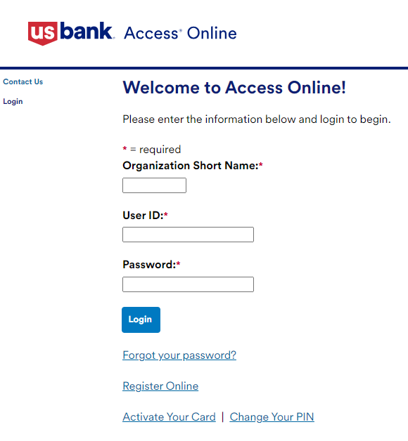
Setting Up Online Account:
Visit www.access.usbank.com
Click Activate Your Card

Slide 16
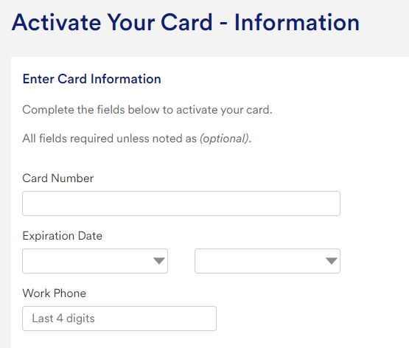
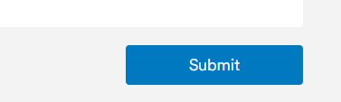
Setting Up Online Account:
Visit www.access.usbank.com
Click Activate Your Card
Enter Card Number, Exp Date, Year, Last 4 of work phone
With department cards, you will need to reach out to Resources Management to see what work number was entered when signing up for the card
4. Click Submit
You will then receive two emails
– one with a link to verify your email address
– the second one with a passcode to enter into the link received in the first email
From there you will set up a new pin and then be redirected back to the main screen

Slide 17
Setting Up Online Account:
Visit www.access.usbank.com
Click Activate Your Card
Enter Card Number, Exp Date, Year, Last 4 of work phone
Click Submit
Register Online
  From here you will begin to build your account
  The Account Number is your Card Number
  Organization Short Name is STOFMS
  You will need to create a User ID and password for your card – make sure you remember your information*

Slide 18
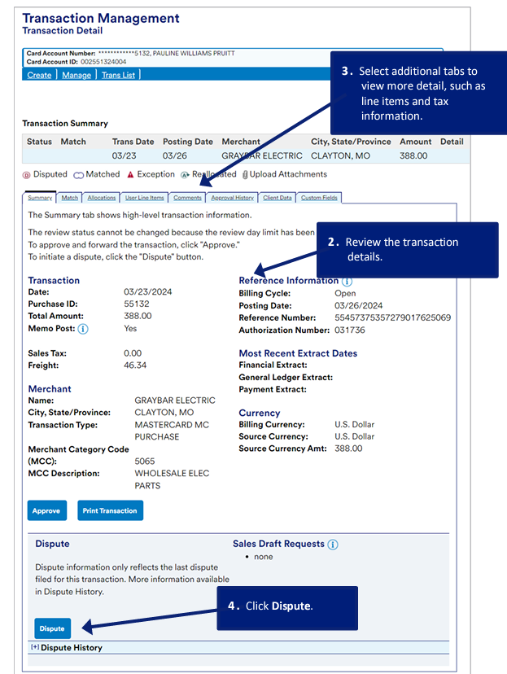
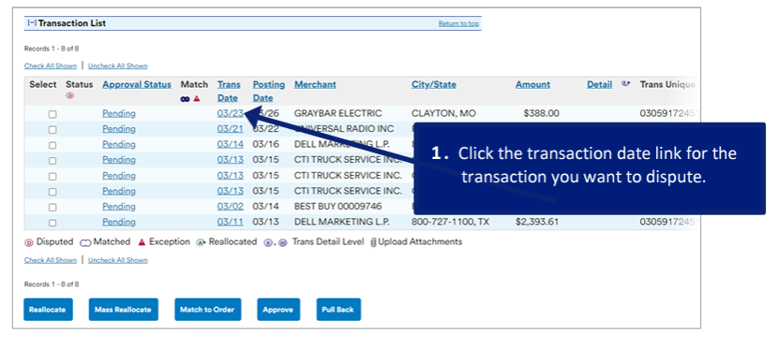
Fraudulent Charges
With having full access to your account online, you will be able to see all pending and posted transactions.
If there is a charge on your card that is fraudulent and not authorized by the cardholder or authorized department member, click the TRANSACTION DATE link on your online statement

Slide 19
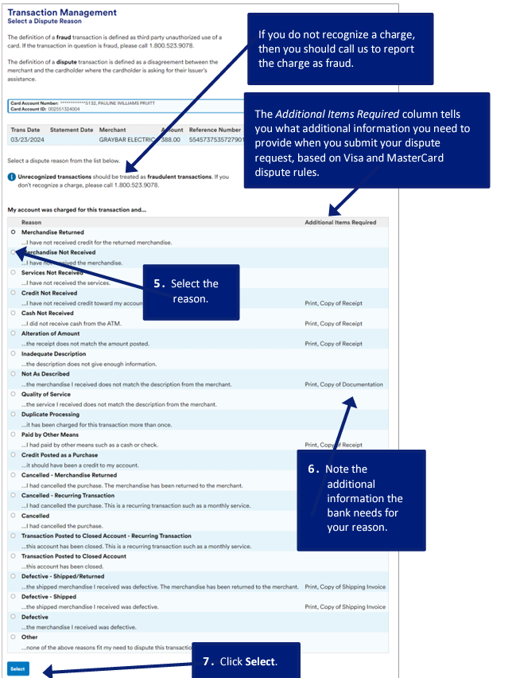
Fraudulent Charges
After viewing the transaction details and clicking dispute you are brought to the Dispute Reasons page.
From here – if the charge was not authorized, you are give a phone number to call the card company.
The other options are reasons why the product was disputed other than a fraudulent charge.

Slide 20
Lost or Stolen Cards
Please inform Resources Management that your card has been lost or stolen.
You are required to Contract USBank
800.344.5696 (toll free)
701.461.2010

Slide 21
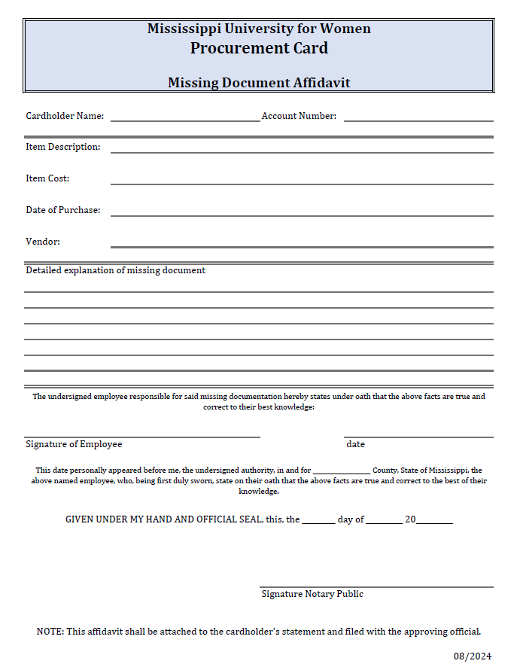
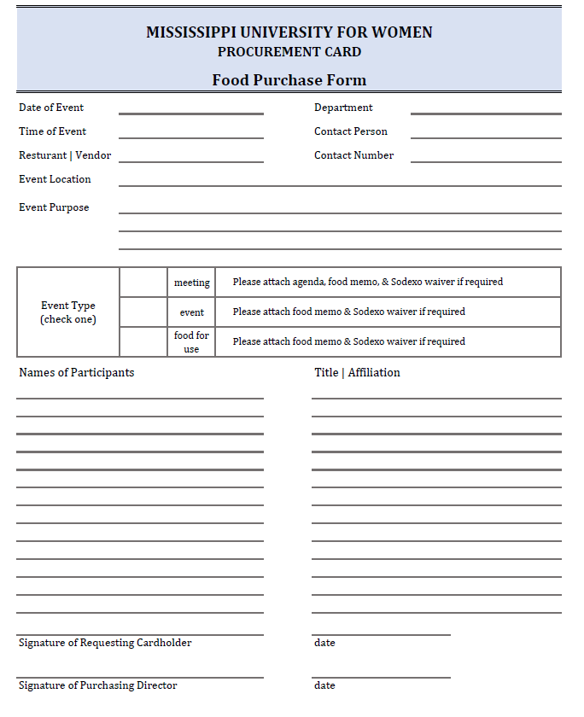

Slide 22
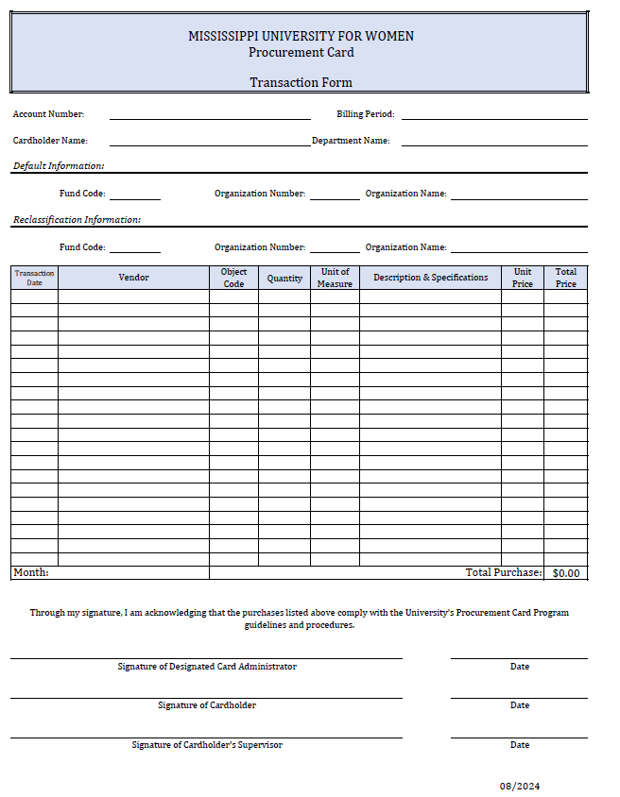
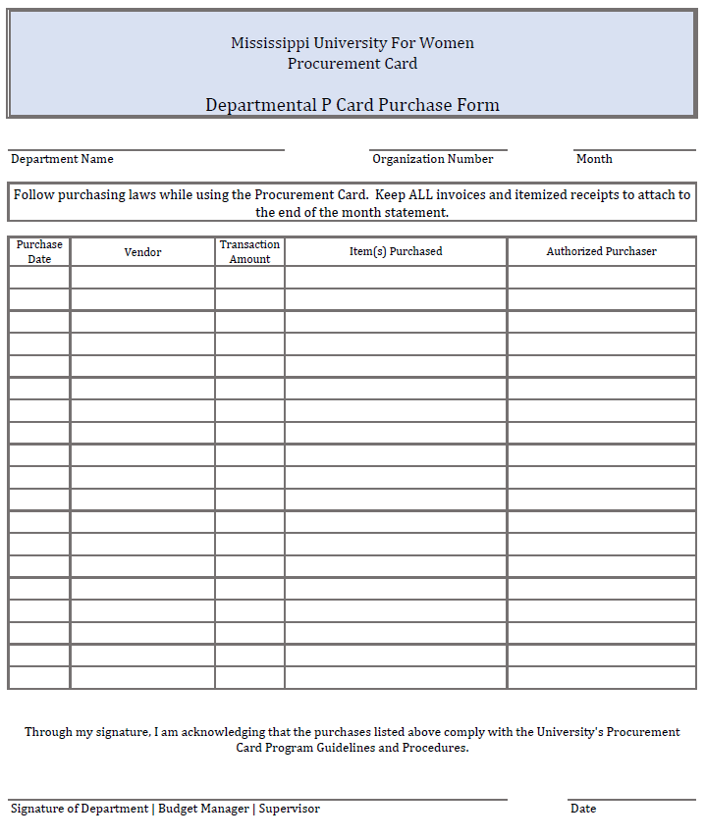
New Form

Slide 23
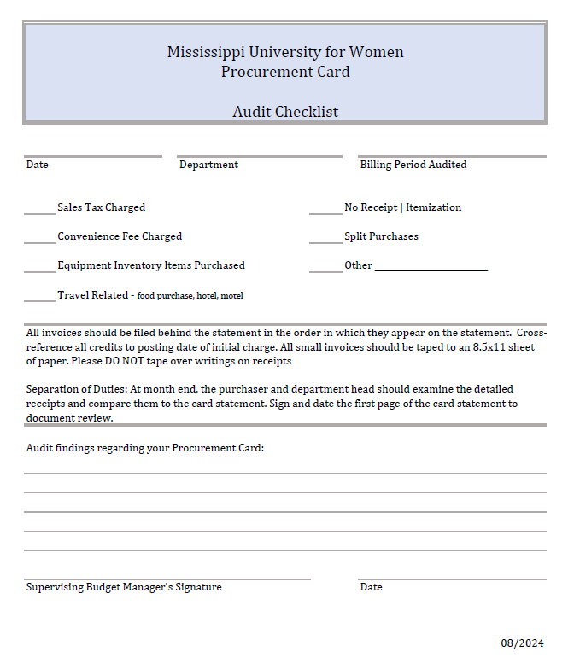
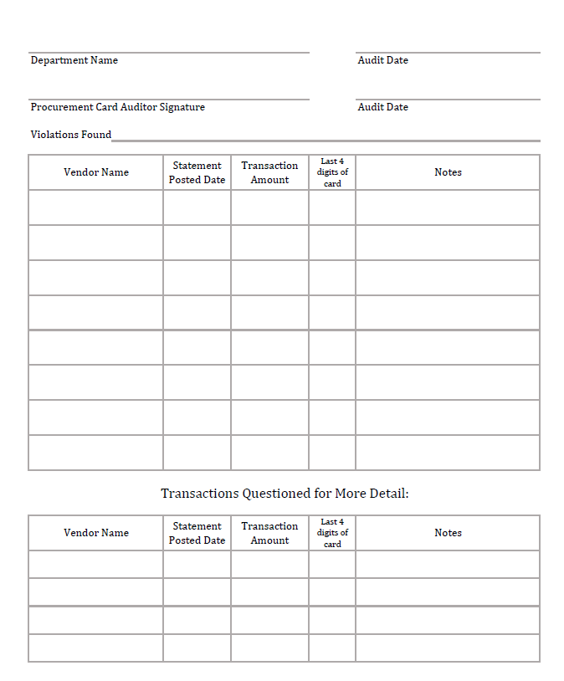
This audit sheet will be sent if there is a violation. If a sticky note is sent back with your statement we are only requesting less critical information.

Slide 24

Bottom line –
I care about each of y’all but I don’t look good in stripes
We require a lot from each of you because this is the State of Mississippi’s money – not ours
Keep that in mind when making purchases

