Slide 1

Basic Departmental Internal Controls
Office of Internal Audit 2020
www.muw.edu

Slide 2
Why am I Here?
The purpose of this training is to inform employees as to what are internal controls, and why they are needed within a department.
As an added bonus, I will be demonstrating how to Blind the Auditor With Brilliance by showing you what I look for during a Basic Control Assessment (BCA).
www.muw.edu

Slide 3
Internal Controls
www.muw.edu

Slide 4
What are Internal Controls?
Internal Controls are processes that provide reasonable (not absolute) assurance that particular objectives are achieved.
Control activities include a range of activities such as:
– Approvals
– Authorizations
– Verifications
– Reconciliations
– Security of assets
– Segregation of duties
www.muw.edu

Slide 5
Why Do We Need Internal Controls?
We use Internal Controls for the following purposes:
Protect MUW/State of MS Assets
Ensure Records are Accurate
Promote Operational Effectiveness & Efficiency
Encourage Adherence to Policies
Ensure Compliance with Laws, Regulations, and Contracts
www.muw.edu

Slide 6
Types of Internal Controls
Control Activities ‐ Actions, supported by policies and procedures, to manage risk.
PREVENTIVE
DETECTIVE
Proactive controls to prevent loss
Designed to discourage errors or prevent irregularities from occurring
Examples:
Segregation of Duties
Transaction Approvals
Adequate Documentation
Physical Control over Assets
Provide evidence a loss has occurred
Designed to find errors or irregularities after they have occurred
Examples:
Reviews
Reconciliations
Physical Inventories
Analysis or Variance Analysis
www.muw.edu

Slide 7
Area of Responsibility
University
Administration
University
Employees
University
Internal Audit
Responsible for promoting and maintaining a rigorous environment in which strong internal controls are mandated and monitored. They have a legal and ethical obligation to adequately support fraud prevention and detection efforts, including the development of strong fraud and conflict of interest policies.
Responsible for upholding its values and ethics in their actions. They should examine internal controls in their own operations and work with their supervisors to strengthen weak controls. They are obligated to report any suspicion or knowledge of unethical or fraudulent actions to the University's Office of Internal Audit.
Responsible for appraising the adequacy and effectiveness of internal controls. We evaluate whether controls provide reasonable assurance objectives are being met. We also investigate reported fraud and actively search for fraud during audit engagements.
www.muw.edu

Slide 8
Recommendations
Ensure state assets are used for state business
Set a strong example for the expectation of ethical behavior, compliance with laws/policies, and communicate your expectations routinely
Limit signature authority and don’t let anyone sign your name (an employee should sign their own name); never use a signature stamp
Be familiar with state policies and procedures; be willing to call and ask questions
Consider unique risks your unit may have (ex: cash collections, contracts, grants, etc.) and ensure additional oversight is provided
Ensure accounts are reconciled monthly and review reconciliations for any unusual transactions (this should include a review of payroll and leave reports)
Don’t let one employee have complete control of any process
www.muw.edu

Slide 9

Basic Control Assessment (BCA)
www.muw.edu

Slide 10
Basic Control Assessment Areas
Account Reconciliation
Leave/Comp Time/ Hours Worked
Payroll
Change Funds
Cash Receipts & Handling
Procurement Card
Property Management
Fleet Management
Facilities Management
Sponsored Research
Information Security
General Administration
www.muw.edu

Slide 11
A. Account Reconciliation
“Account Reconciliation Procedures”, available at: https://www.muw.edu/accounting/facstaff/budgets
Responsibilities of Individual Departments
Reconciliations should be performed timely (monthly) for all active accounts
Methods of reconciliation will vary depending on the size of the department and number of active accounts
Reviews of account reconciliation should be performed by the Budget Manager (DH) or Principal Investigator (PI) to ensure accuracy
Reconciliations should be supported by a detailed Banner Ledger Report (FGRODTA)
Treat the ledger report like a bank statement
Look for strange transactions or unknown vendors
Periodically ask about vendors and request the invoice
(PayPal, Amazon, etc.)
www.muw.edu

Slide 12
A. Account Reconciliation
Documentation exists to support timely reconciliation of departmental accounts on a consistent basis.
Should be completed timely and consistently
Supported by detailed ledger report (FGRODTA);
Should include evidence that the Detailed Banner Ledger Report was reviewed by the Department Head/Designee
Signed by reconciler
Signed by reviewer
Grant accounts must be reviewed/signed by the Principal Investigator
www.muw.edu

Slide 13
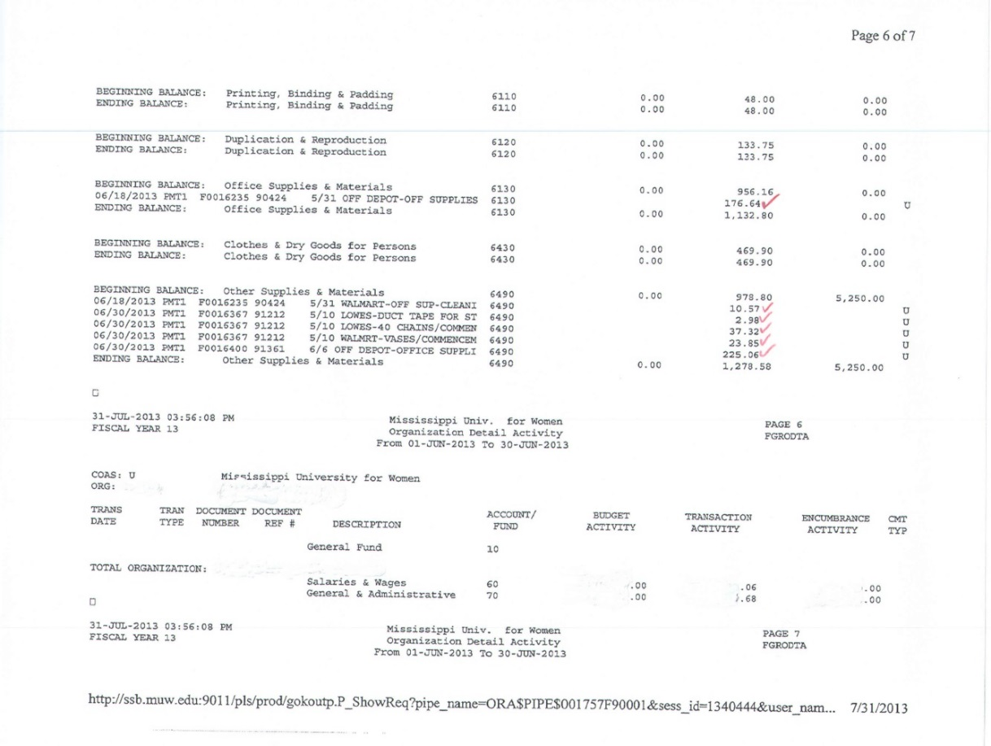
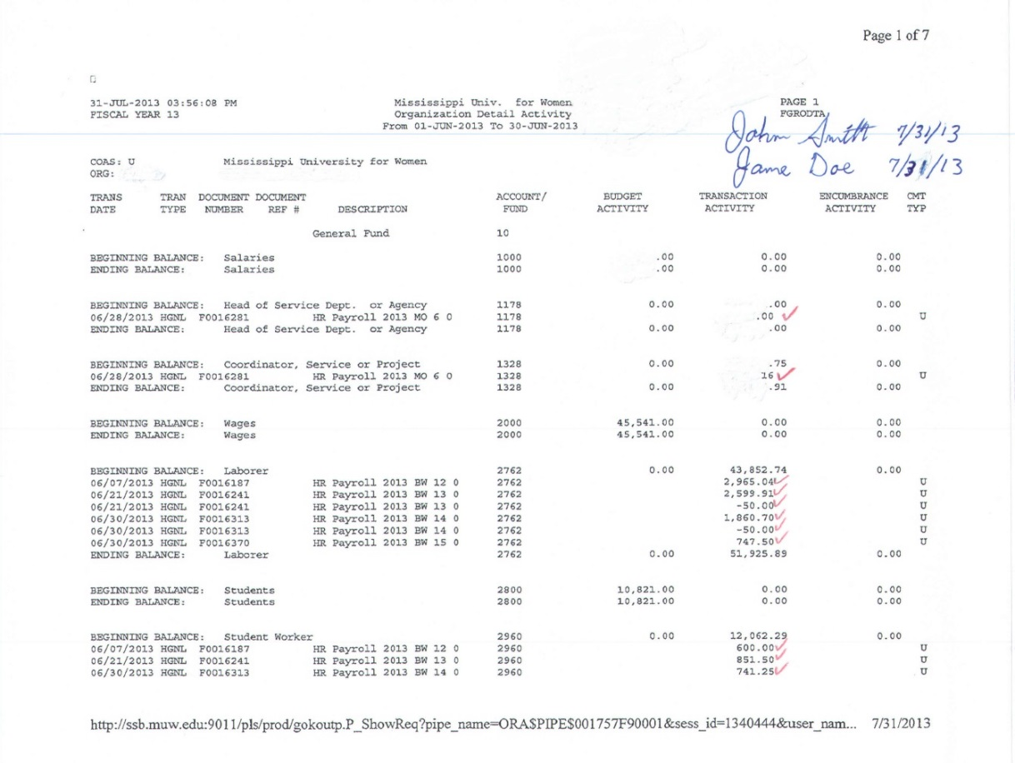
A. Account Reconciliation
Signed by reconciler
Signed by reviewer (dept head or PI for grants)
Timely
www.muw.edu

Slide 14
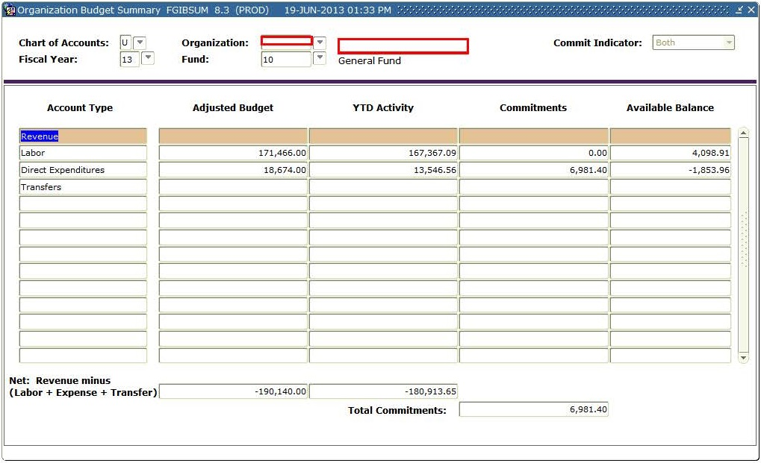
A. Account Reconciliation
Departmental account fund balances appear adequately provided for without significant deficits.
Accounts with negative available balances compared to budget.
www.muw.edu

Slide 15
B. Leave/Comp Time/Hours Worked
See: “Employee Handbook”, “IHL Policies and Bylaws” & Miss. Code Ann. § 25-1-98.
Office Hours Work Schedule
Miss. Code Ann. § 25-1-98 – …”construction of “workday”
…all state offices shall be open and staffed for the normal conduct of business from 8:00 a.m. until 5:00 p.m., Monday through Friday”
“A workday for a state employee in a full-time employment position … (8) hours in duration… shall develop work schedules which ensure … full-time employee works a full workday …provide the State Auditor with a copy of the regular work schedule…
Courses during Normal Working Day
Employees may enroll in one course during normal working day with prior approval of the unit head provided the time lost from work (including travel to and from class) is made up during the same work week, or, compensated for by the use of leave or comp time. Additional courses must be taken during non-work hours.
In General, when you are “Working” you should be performing MUW business.
www.muw.edu

Slide 16
B. Leave/Comp Time/Hours Worked
All eligible employees appear to be accurately reporting hours worked, comp time earned and used, and leave earned and used. Must document reconciliation/review by signing and dating leave reporting forms by employee and supervisor.
Applies to all employees, faculty and staff.
Being reviewed by our office during assessments and annually university wide.
The authorizing or taking leave without the completion and submission of appropriate leave forms is considered a misuse of assets and would be subject to disciplinary action.
Documentation exists to support that leave usage and balances are accurately maintained and reconciled timely.
Each Supervisor is responsible for reviewing leave reporting forms to ensure:
Hours worked shown on leave reporting form agrees with timecards
All leave taken is reported
Proper beginning balances and accrual rates are used
Comp time earned was properly approved and calculated
Comp time used before personal leave
Reconciliations are accurately calculated
www.muw.edu

Slide 17
B. Leave/Comp Time/Hours Worked
www.muw.edu

Slide 18
B. Leave/Comp Time/Hours Worked
Documentation exists to support that hours worked by student workers and employees utilizing time cards are accurately maintained and reconciled timely.
Each Supervisor is responsible for reviewing time reporting forms to ensure
Hours worked shown on time reporting form agrees with employee’s work schedule
Proper pay period is being documented
Employee properly completed and signed time reporting form
Supervisor must document review by signing and dating time reporting forms by employee.
www.muw.edu

Slide 19
B. Leave/Comp Time/Hours Worked
www.muw.edu

Slide 20
B. Leave/Comp Time/Hours Worked
Hours worked by student workers and employees utilizing time cards are reconciled to the time reported on MUWTIME vouchers.
Each Supervisor is responsible for reviewing time reporting forms to ensure
Hours worked shown on time card/time log agrees with time submitted on MUWTIME voucher.
Proper pay rate is documented on MUWTIME
Supervisor must document review by signing and dating MUWTIME voucher.
www.muw.edu

Slide 21
C. Payroll
Supervisors must reconcile hours worked and pay rate shown on the BW Hours payroll reconciliation report for each employee to the hours worked and pay rate submitted on the MUWTIME voucher.
Supervisors must reconcile the Gross Pay shown for each employee on the Monthly Reconciliation Report to the employee’s approved monthly pay.
Look for:
Payroll accuracy
Any unknown employees (ghost employees) or employees that have been terminated.
Any overtime, other, or special pay
Supervisor’s must document this review by signing and
dating the payroll reports.
www.muw.edu

Slide 22
D. Change Funds
“Cash C & D Procedures”, available at: https://www.muw.edu/accounting/facstaff/receipts
Departmental Petty Cash Fund
Departments are not authorized to maintain petty cash funds. All purchases and refunds must be processed through Resources Management and University Accounting.
Department Change Fund
Permanent Change Fund
Departments can request a permanent change fund through University Accounting. Upon authorization, a change fund will be issued by University Accounting. The change fund should only be used to make change during cashiering operations and cannot be used for expenditures. Departments should assign a custodian responsible for the accountability of these funds. The custodian of the fund is responsible for the safekeeping of the fund and for its proper usage. University Accounting will make periodic audits to verify that all funds are accounted for.
Temporary Change Fund
If a temporary change fund is needed (i.e. Theatre Performances, Welty Symposium, Orientation, etc.), the request should be made on a direct pay form and signed by the departmental Budget Manager. These funds will be the responsibility of the employee requesting the money.
The funds should be returned to University Accounting within 15 days of the event.
The employee will have an outstanding receivable balance until these funds are returned.
www.muw.edu

Slide 23
D. Change Funds
Change Fund is properly approved
If you receive cash, how do you make change unless you have a change fund
Change Fund is properly reconciled and reflects approved amount
Cash appears to be adequately safeguarded
Change fund and cash receipts should be kept secure, preferably locked away in a fireproof safe or file cabinet
www.muw.edu

Slide 24
E. Cash Collection & Deposit
“Cash C & D Procedures”, available at: https://www.muw.edu/accounting/facstaff/receipts
Responsibilities of Individual Departments
Each department is responsible for developing detailed written departmental operating procedures that comply with the University’s Cash Collection and Deposit Procedures. University Accounting is available for consultation and review of departmental procedures.
Segregation of Duties in Campus Departments
There should be a separation of duties between the person receiving/processing/depositing cash and the person responsible for reconciling and maintaining the accounting records. Cash receipt activity should be reconciled to Banner at on a monthly basis. The reconciliation should be reviewed and approved by someone independent of the
individual handling the cash and preparing the deposit.
www.muw.edu

Slide 25
E. Cash Collection & Deposit
“Cash C & D Procedures”, available at: https://www.muw.edu/accounting/facstaff/receipts
Safeguarding Funds
All forms of cash (currency, checks, money orders, credit card transactions) should be kept in a secure place. Access should be restricted to authorized personnel. Checks, money orders, traveler’s checks, etc. should be made out to “Mississippi University for Women” or “MUW”. Checks should be endorsed immediately upon receipt and should include the name of the depositing department.
Departmental Petty Cash Fund
Departments are not authorized to maintain petty cash funds. All purchases and refunds must be processed through Resources Management and University Accounting.
www.muw.edu

Slide 26
E. Cash Collection & Deposit
“Cash C & D Procedures”, available at: https://www.muw.edu/accounting/facstaff/receipts
Frequency of Deposits
Any money received should be deposited promptly to University Accounting. Deposits should be made at least weekly or when cash on hand reaches $100, whichever comes first.
Departments are prohibited from making refunds, paying expenditures or creating a change fund from cash receipts. Postdated checks should not be held for future processing.
Under no circumstance is it permissible for cash receipts to be used to cash a check. If your department accepts credit cards and has a credit card terminal, it should be settled daily unless your terminal is setup for automatic settlement.
www.muw.edu

Slide 27
E. Cash Collection & Deposit
“Cash C & D Procedures”, available at: https://www.muw.edu/accounting/facstaff/receipts
Customer Receipts
When payments are received in person, it should be immediately recorded on a pre-numbered two-part receipt. (The only exception would be in the case where pre-numbered tickets are sold.) One copy of the receipt should be given to the customer and one copy should be maintained by the department in the receipt book. Receipts should be issued in sequential order. If a receipt is voided, both copies of the voided receipt should be maintained by the department for sequence accountability and audit. This can be accomplished by stapling the original voided receipt to the departmental copy in the receipt book.
When opening mail, all checks should be logged into the department’s check log and immediately endorsed.
Once the payments have been receipted or logged, the funds should immediately be safeguarded until deposited with University Accounting. The receipt books and payment logs (rather than the checks), in conjunction with the receipt received from University Accounting, can then be used to reconcile cash receipts in Banner.
www.muw.edu

Slide 28
E. Cash Collection & Deposit
“Cash C & D Procedures”, available at: https://www.muw.edu/accounting/facstaff/receipts
Deposit Form and Supporting Paper Trail
A Receipt Form must be used for all deposits made with University Accounting. The receipt form can be found at http://web2.muw.edu/images/admin_offices/office_finance_administration/comptroller/Receipt_Form.pdf . This form is used to communicate and document deposits made by departments and University Accounting to Banner.
An itemized list of payments or a copy of the check(s) should be included with the form. The list should include payer, student name/id # or customer name if different than the payer, check number, amount, etc.
How to Transport Deposits
Deposits should be hand-delivered by a department representative to University Accounting.
Deposits should not be sent via interdepartmental mail.
www.muw.edu

Slide 29
E. Cash Collection & Deposit
“Cash C & D Procedures”, available at: https://www.muw.edu/accounting/facstaff/receipts
Department Reconciliation
At least monthly, a person other than the person handling cash receipts should:
Reconcile deposits in Banner to the Receipt Forms submitted
Reconcile the Receipt Forms to the customer receipt trail (i.e. receipt book, check receipt log, ticket stubs, etc.)
Department Approval
Budget Managers should review and approve reconciliations. Review Banner along with detail activity and perform regular analytical review of balances for reasonableness based on expectations. Such reviews should be documented and signed by the Budget Manager as proof the procedure is being
followed.
www.muw.edu

Slide 30
F. Procurement Card (P-Card)
“Procurement Card Manual”, available at: http://www.muw.edu/images/admin/admin/resources/purchasing/procurement//procurement_card_manual.pdf
P-Card Statements properly reconciled to supporting documentation and signed and dated by card holder and reviewed/signed/dated by Supervisor
Transaction Form properly completed and signed by card holder and reviewed/signed/dated by Supervisor
Supporting documentation attached and required forms properly completed and attached
Submitted to Resources Management timely.
www.muw.edu

Slide 31
G. Property Management
“Equipment Management Procedures Manual”, available at: http://www.muw.edu/images/admin/admin/resources/property/inventorymanual2009.pdf
Annual Physical Inventory properly performed, inventory listing signed by inventory representative and supervisor/3rd party
– Adequate internal controls require having more than one person involved in custody/monitoring/processing of assets
Hand receipts must be used for the removal of property off campus & updated semi-annually
– You should be able to produce the asset or a hand receipt at all times
– We recommend that a hand receipt be completed for any portable assets (such as laptops) assigned to an employee
www.muw.edu

Slide 32
H. Fleet Management
“Rules and Regulations Fleet Manual”, available at: https://www.muw.edu/resources/fleet/vehicles#forms
Documentation exists to support adherence to Fleet Management Guidelines
Documentation would include appropriate vehicle records, employee/driver documentation, Fuelman purchase reconciliation and fuel usage analysis, etc
www.muw.edu

Slide 33
I. Facilities Management
Ensure the locksmith has an accurate record of all keys issued
Perform a periodic analysis of missing keys to ensure adequate security
When was the last time your office, suite, or building was keyed/rekeyed?
Are all keys issued accounted for? No lost or missing keys?
Are your people/students, property, and information adequately secured?
Have you reduced the chance that access to sensitive/restricted areas could be gained by unauthorized persons?
Maintain a listing of any keys available for temporary use to include both issued and unissued keys.
Maintain a check-out/check-in log of keys available for temporary use.
For departments utilizing an electronic key‐card (ID card) access system, periodically review your access listing and make sure only authorized personnel have access.
www.muw.edu

Slide 34
J. Sponsored Programs
“Grant Manual” and the “Principal Investigator and Project Director Criteria” are available at: https://www.muw.edu/osp/policies
Documentation exists to support adherence to the Grant Manual and all University, Sponsoring Agency, and governmental policies and procedures
Timely and accurate completion of Confirmation of Effort reports by someone with suitable means of verification that the work was performed.
www.muw.edu

Slide 35
K. Information Security
Sensitive information is secured
SSN, Financial records (donor, student, employee), Personnel/HR records, Student Records, Research data
Departmental policy should:
Require password protection on computers
Require encryption software on laptops
Completion of the Confidentiality and Security Agreement for employees with access to sensitive information:
Access to new hire paperwork, Financial records (donor, student, employee), Personnel/HR records, Student Records, Research data
Access to Graduate Student applications
Documentation to support compliance with software licensing agreements (proof of ownership/license agreements for installed software)
www.muw.edu

Slide 36
L. General Administration
Current desk manual exists for critical departmental controls and procedures
We recommend that a desk manual be developed detailing critical procedures in the event of hiring a new employee or temporary worker substituting for an absent employee
We recommend that the manual detail tasks to be completed daily and tasks completed periodically/monthly with recommended timelines. The manual should be reviewed periodically with any changes noted
Is the Whistleblower poster posted?
www.muw.edu

Slide 37
MUW Ethics Line
A phone and internet-based reporting system managed by an external company EthicsPoint
Basically a reporting tool allowing an individual to anonymously report activities that may involve criminal, unethical, or inappropriate behavior
The Ethics Line is not a substitute for existing reporting channels, but is an additional means of reporting especially when maintaining the reporter’s confidentiality is important
Reports are entered directly on the EthicsPoint secure server to prevent any possible breach in security. EthicsPoint makes these reports available only to specific individuals within the university who are charged with evaluating the report, based on the type of violation and location of the incident. Each of these report recipients has had training in keeping these reports in the utmost confidence
www.muw.edu

Slide 38
Whistleblower Policy
PS# 6708, protects any MUW employee or individual who makes a good faith disclosure of suspected wrongful conduct. Supplements existing Mississippi Code of 1972, § 25-9-171 through 25-9-177
"Wrongful Conduct" is defined in this policy to be
a violation of applicable state and/or federal laws and regulations
a serious violation of University policy
the use of University property, resources, or authority for personal gain or other non University-related purpose except as provided under University policy
"Good Faith Report" is defined in this policy to be an allegation of wrongful conduct made by an individual who believes that wrongful conduct may have occurred. However, an allegation is not in good faith if it is made with reckless disregard for or willful ignorance of facts that would disprove the allegation
www.muw.edu

Slide 39
Whistleblower Policy
Protects individuals from reprisal by adverse academic or employment action taken within the University as a result of having disclosed wrongful conduct
Provides individuals who believe they have been subject to reprisal a process to seek relief from retaliatory acts that fall within the authority of the University
www.muw.edu

Slide 40
Unrelated Business Income
Anything, not related to our primary mission of educating, that we sell to ANYONE
T-Shirts
Medical equipment
Ad revenue
Equipment rental
Space rental (if we provide any service)
Etc.
We must also charge sales tax on everything we sell. While the University is tax exempt, students are not.
www.muw.edu

